Slide 1



How to Create GitHub Account
Guvi-iitm Master science program
Absolute Beginner's

Slide 2
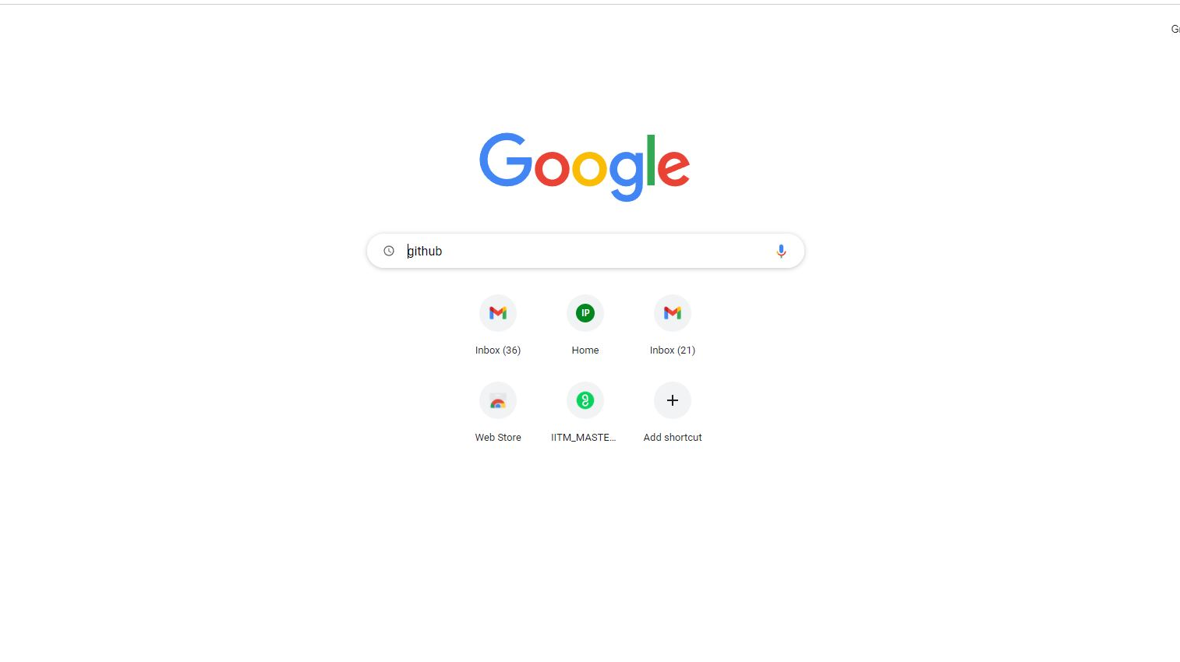
Open Google Browser and type GitHub

Slide 3
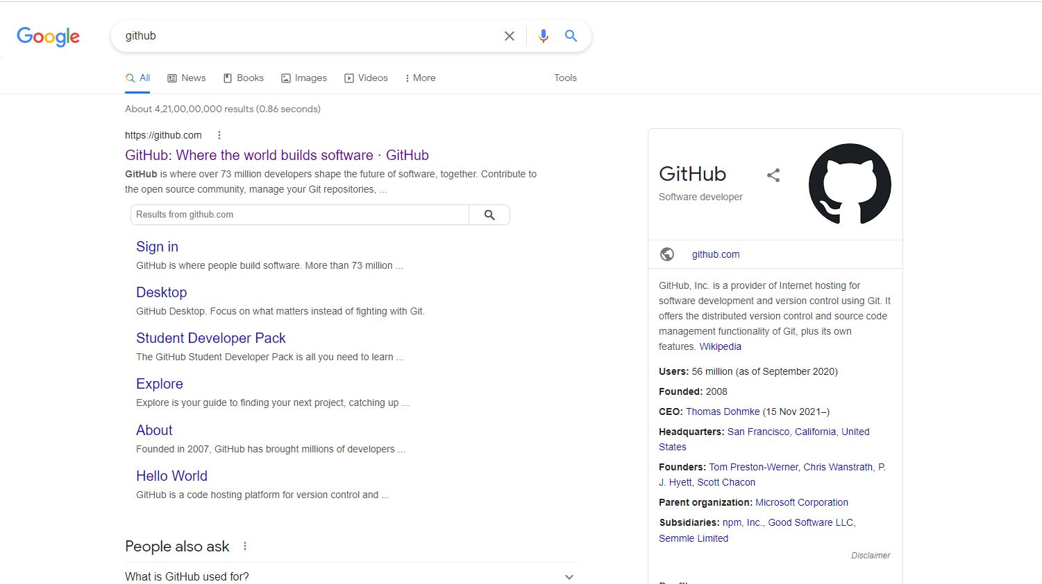
Choose the first option

Slide 4
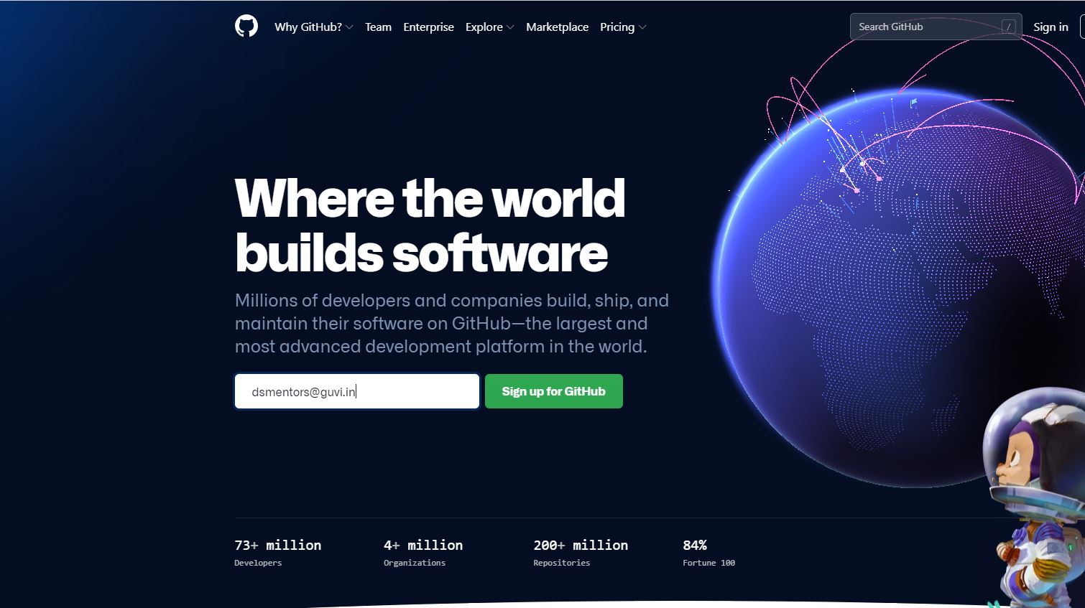
Type your mail id to signup

Slide 5
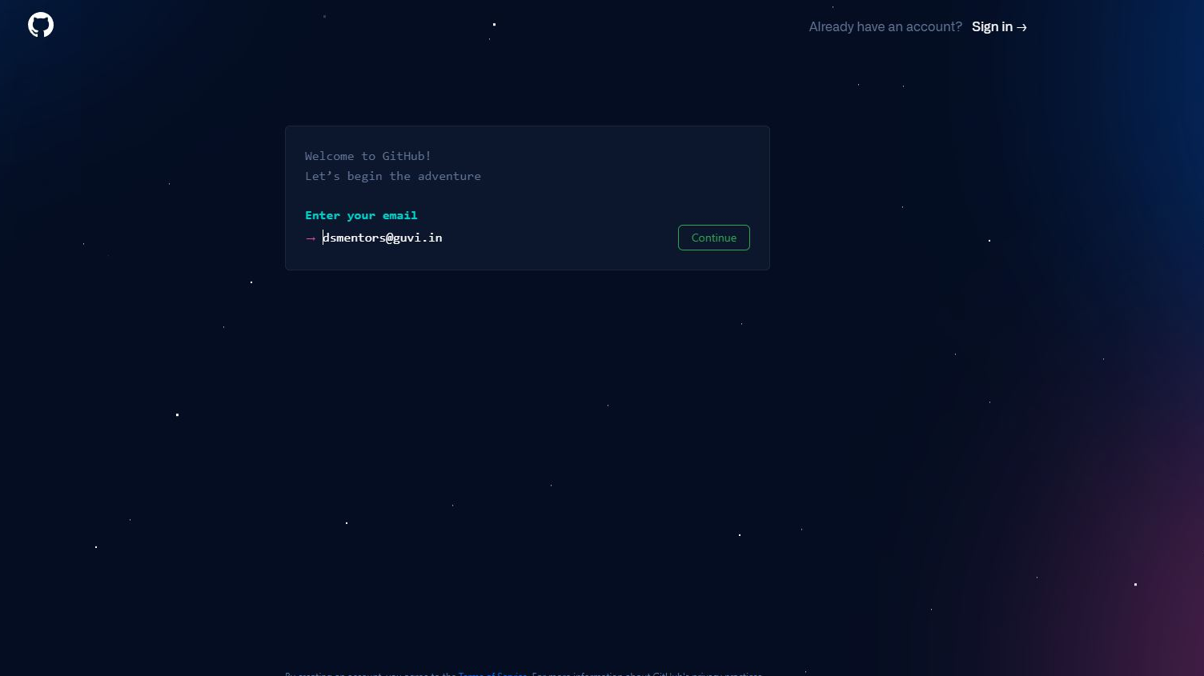
Click the continue button

Slide 6
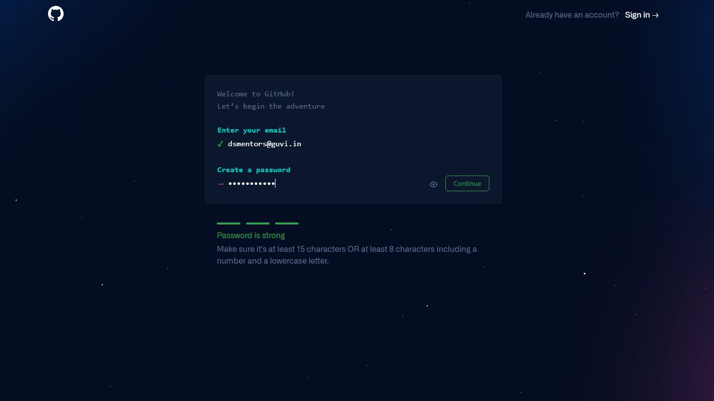
Enter the strong password and press continue

Slide 7
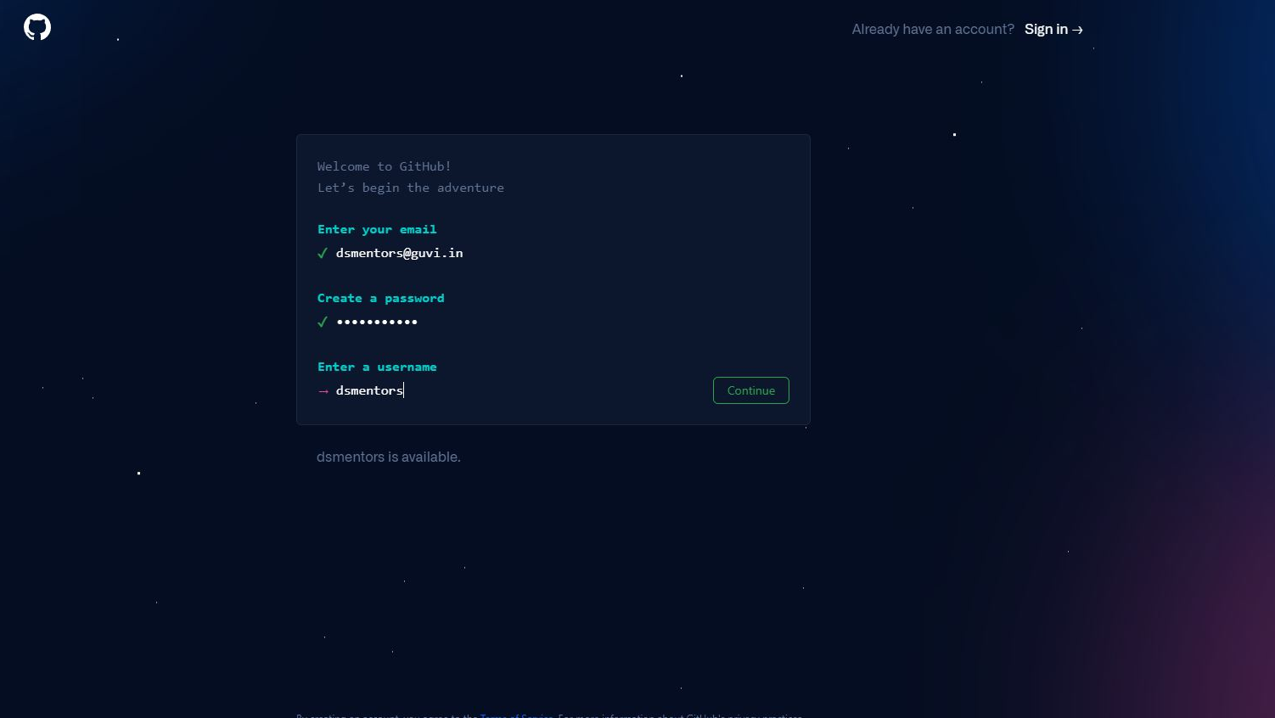
Create a unique username and press continue

Slide 8
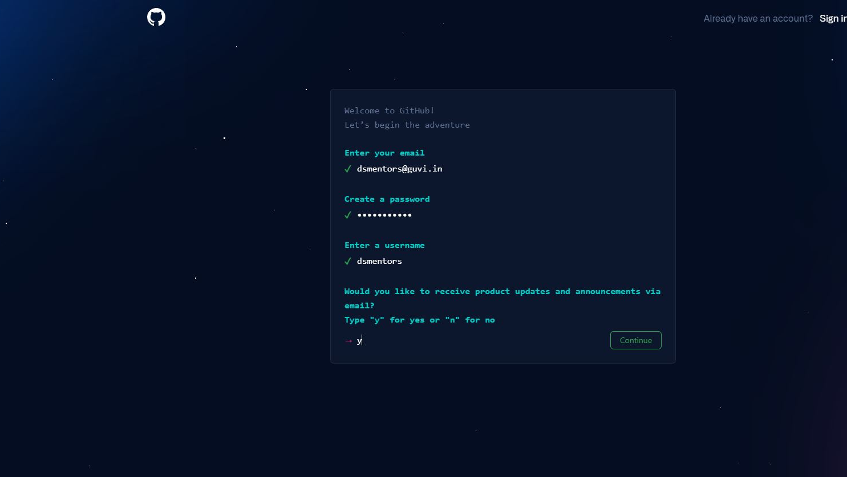
If you want any updates type ‘y’ or type ‘n’ and press continue

Slide 9
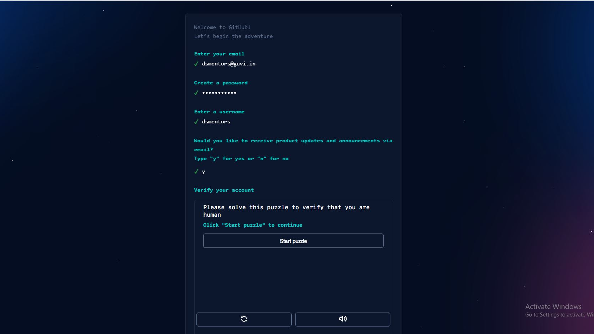
Click start puzzle this step is to verify that you are human

Slide 10
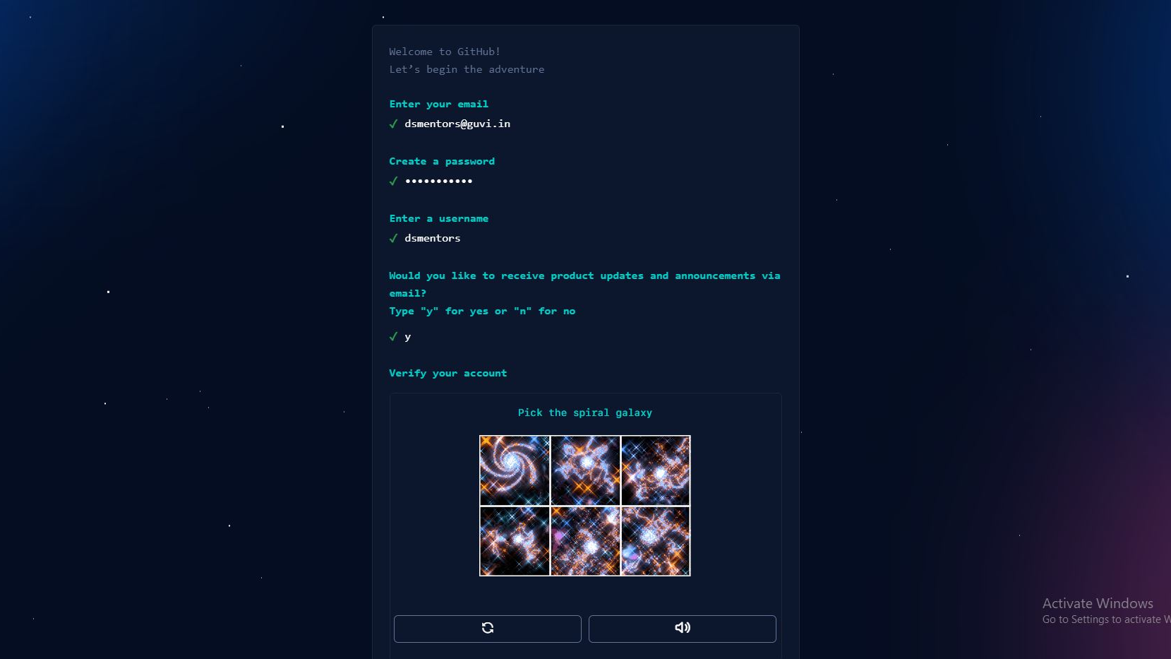
Solve the puzzle

Slide 11
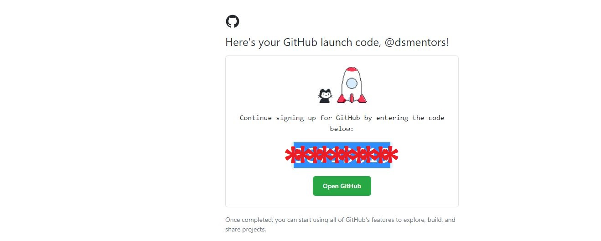
You got 8-digit code in your mail id enter that in verification box to get sign-in

Slide 12
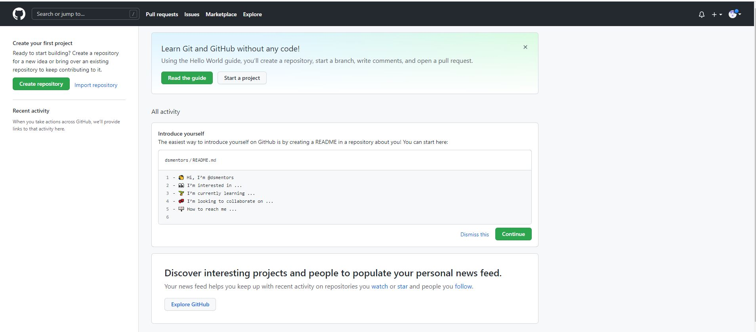
Finally, we have created the Git-Hub Account

Slide 13
Next we can see how to create the Git-Hub Repository

Slide 14
How to Create GitHub Repository
Guvi-iitm Master science program
Absolute Beginner's

Slide 15
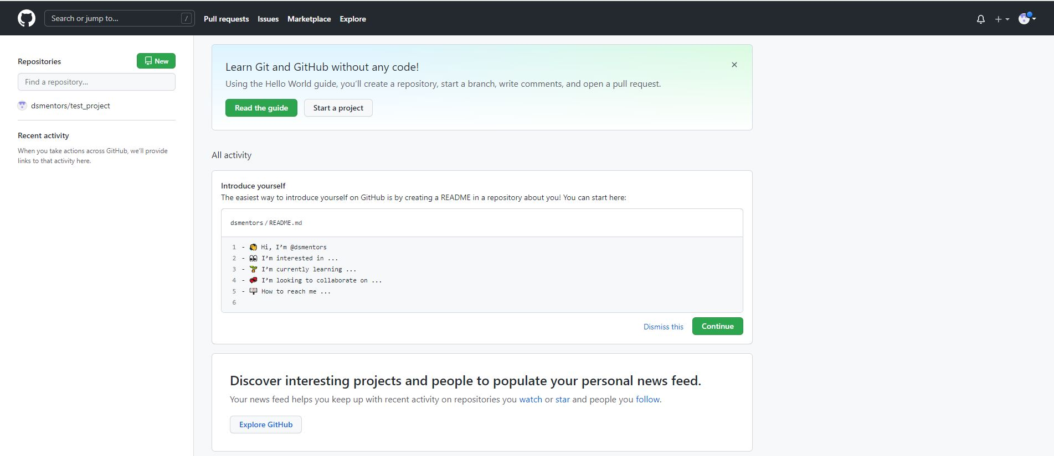
Open Your Git-Hub account and click on ‘+’ button on top right corner

Slide 16
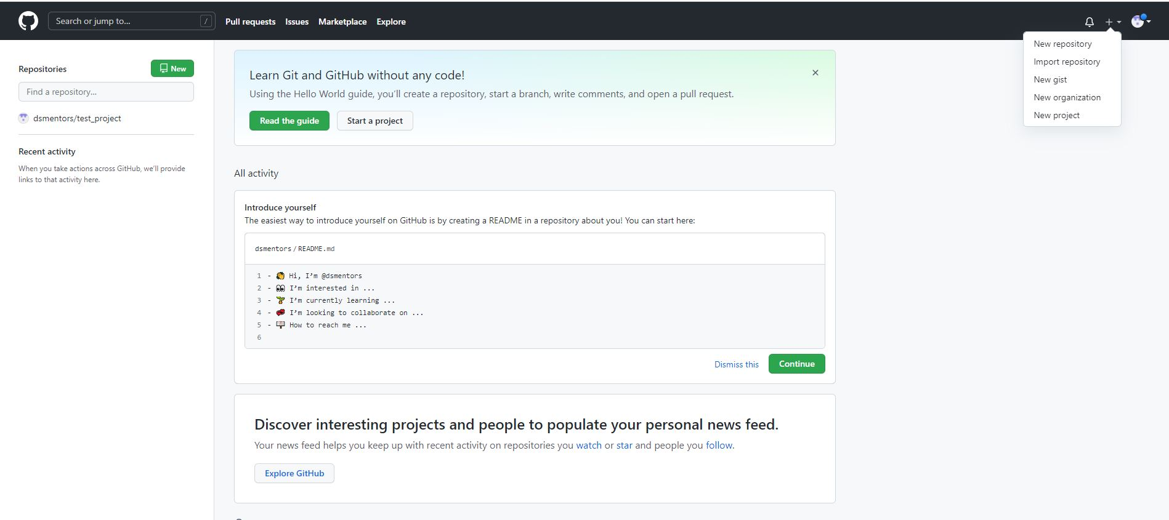
Click on new repository

Slide 17
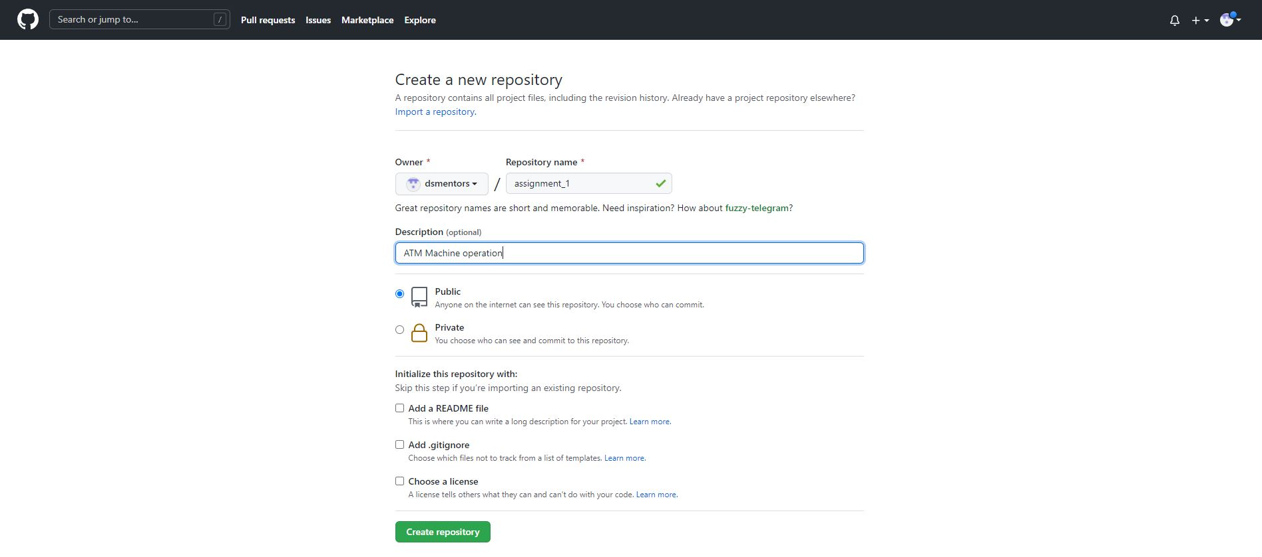
Type the repository name and fill the Brief Description of your project

Slide 18
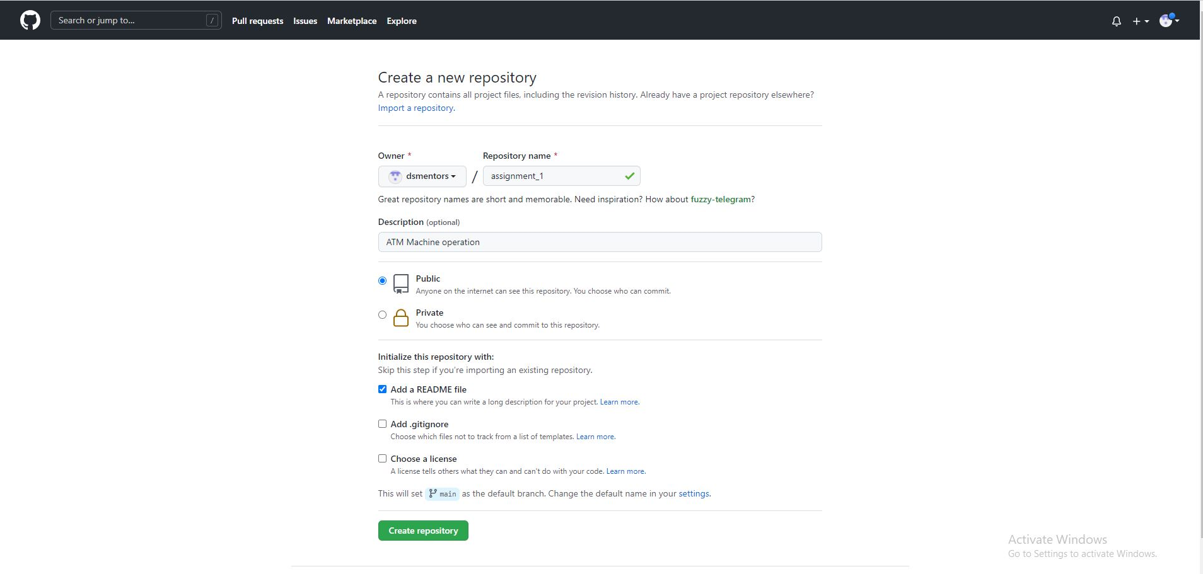
Select the Add a ReadMe File to add the details of the project like Architecture / Wireframe or some description

Slide 19
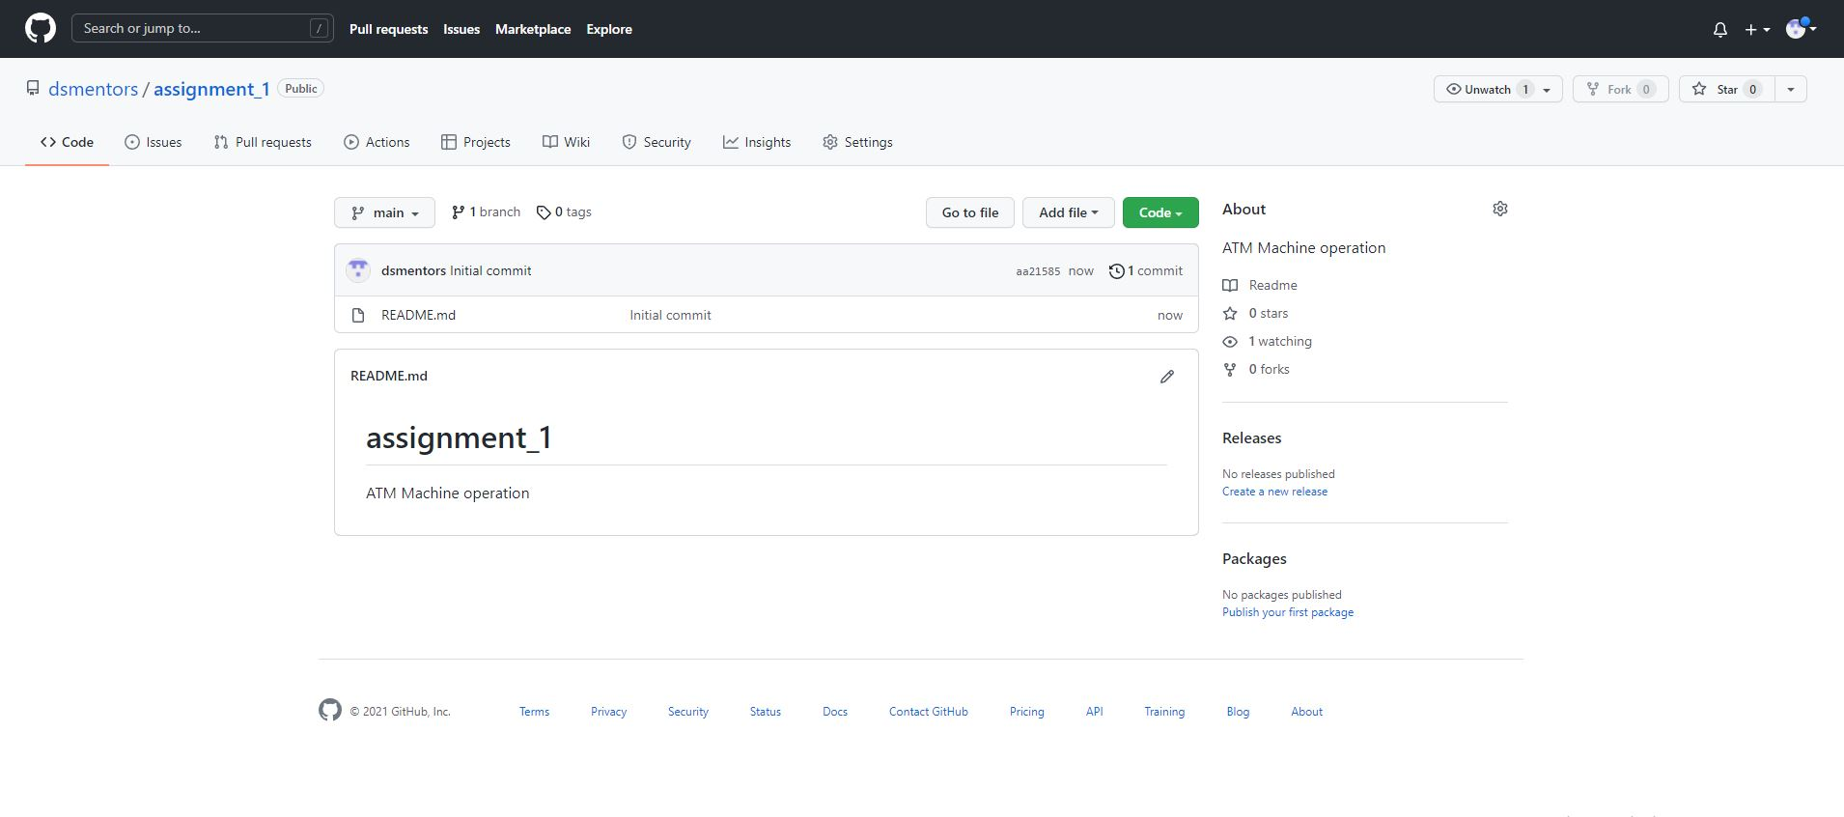

Add the description of project by click in ReadMe file

Slide 20
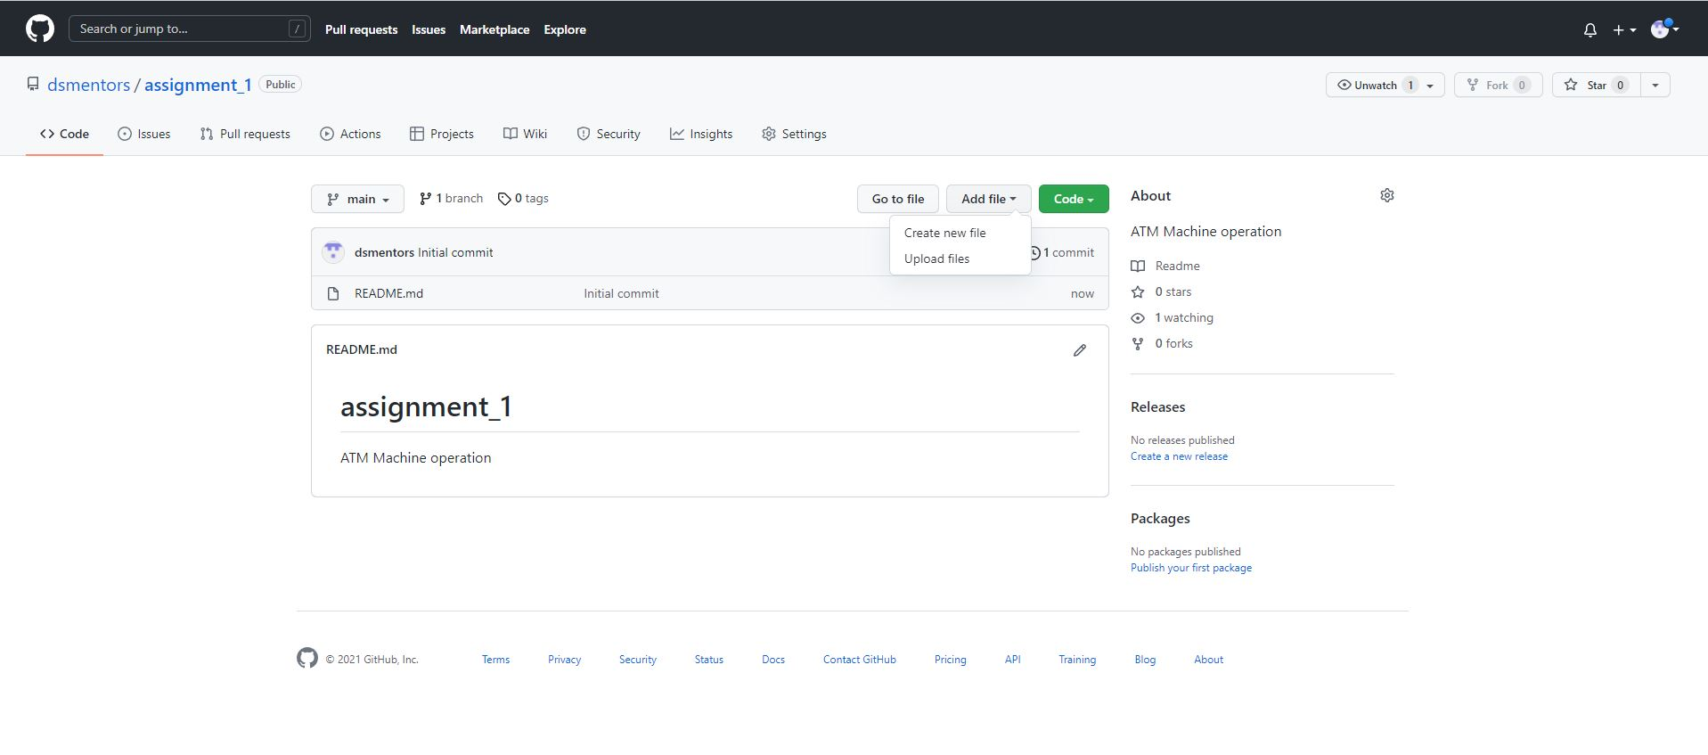
To add project click add file and select upload files

Slide 21
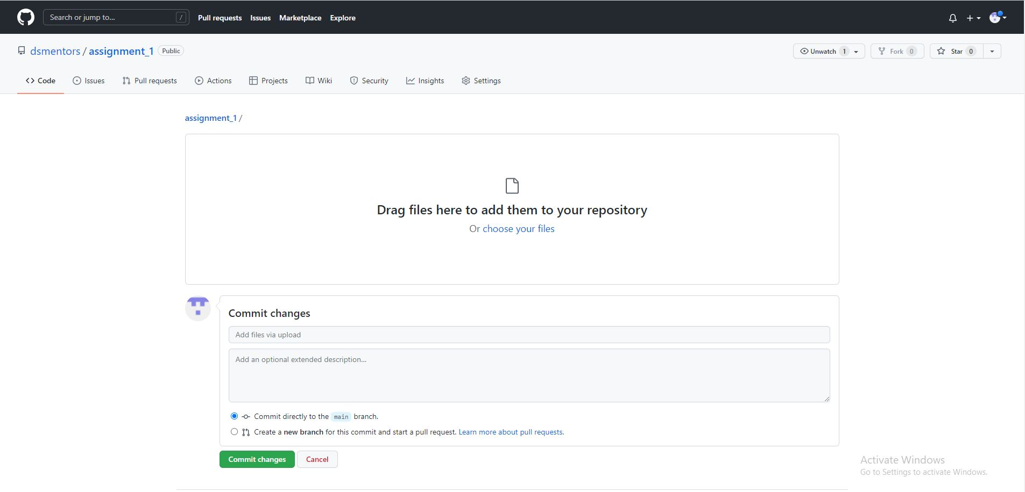
Drag and drop your file in this Area to upload the file

Slide 22
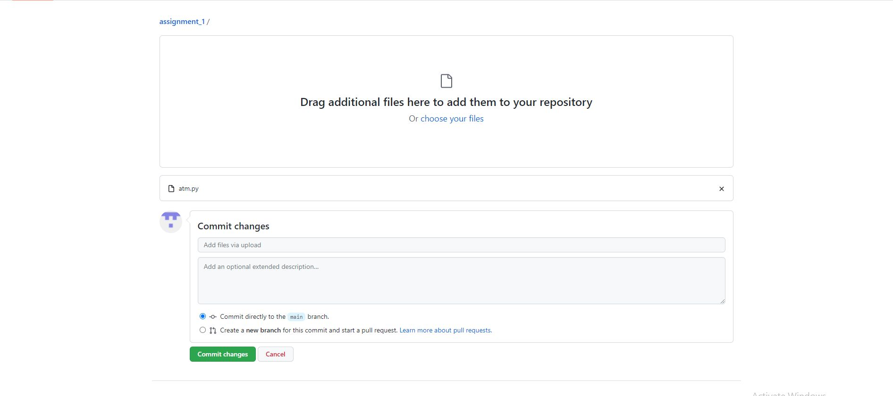
Your file got uploaded add some description and click commit change

Slide 23
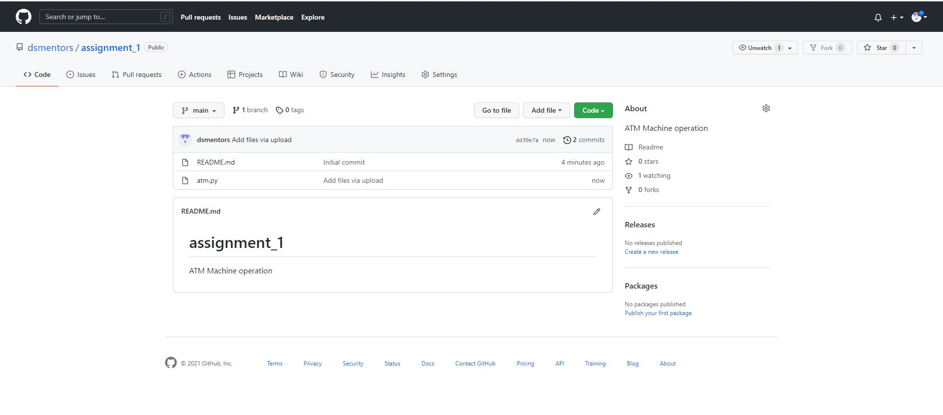
Successful uploaded the project in Git-Hub Repository

Slide 24
Next we can see How to connect the Google Colab with the Git-Hub Repository

Slide 25
How to upload Google colab file into Git-Hub Repository
Guvi-iitm Master science program
Absolute Beginner's

Slide 26
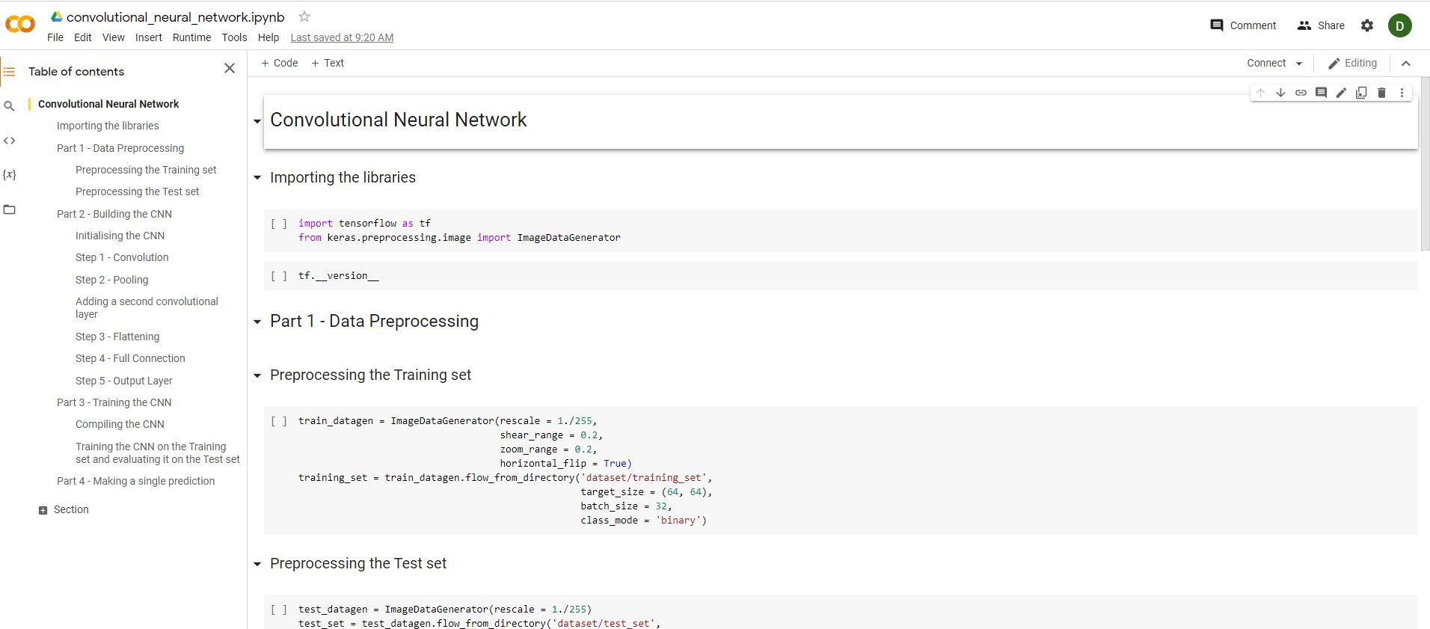
Open your google colab file which you want to link with Git-hub

Slide 27
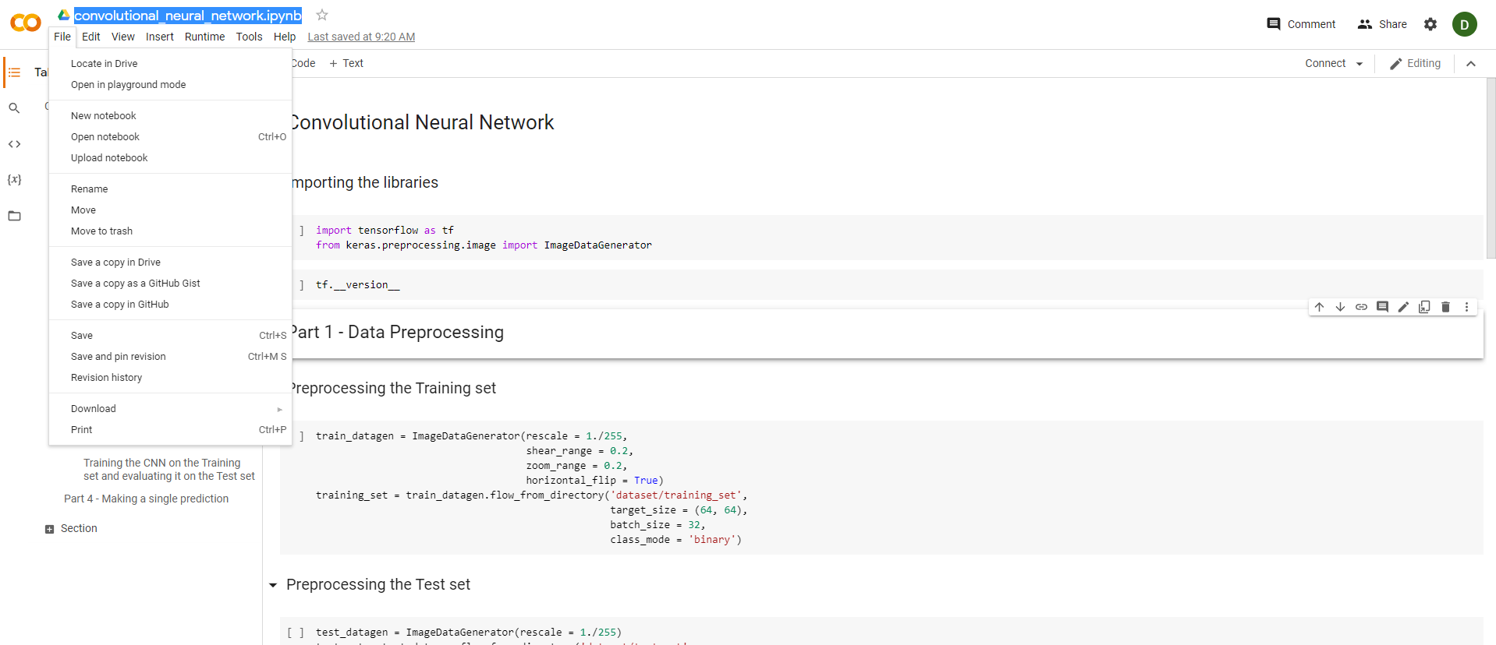
Click the file and select save copy in Git-Hub

Slide 28
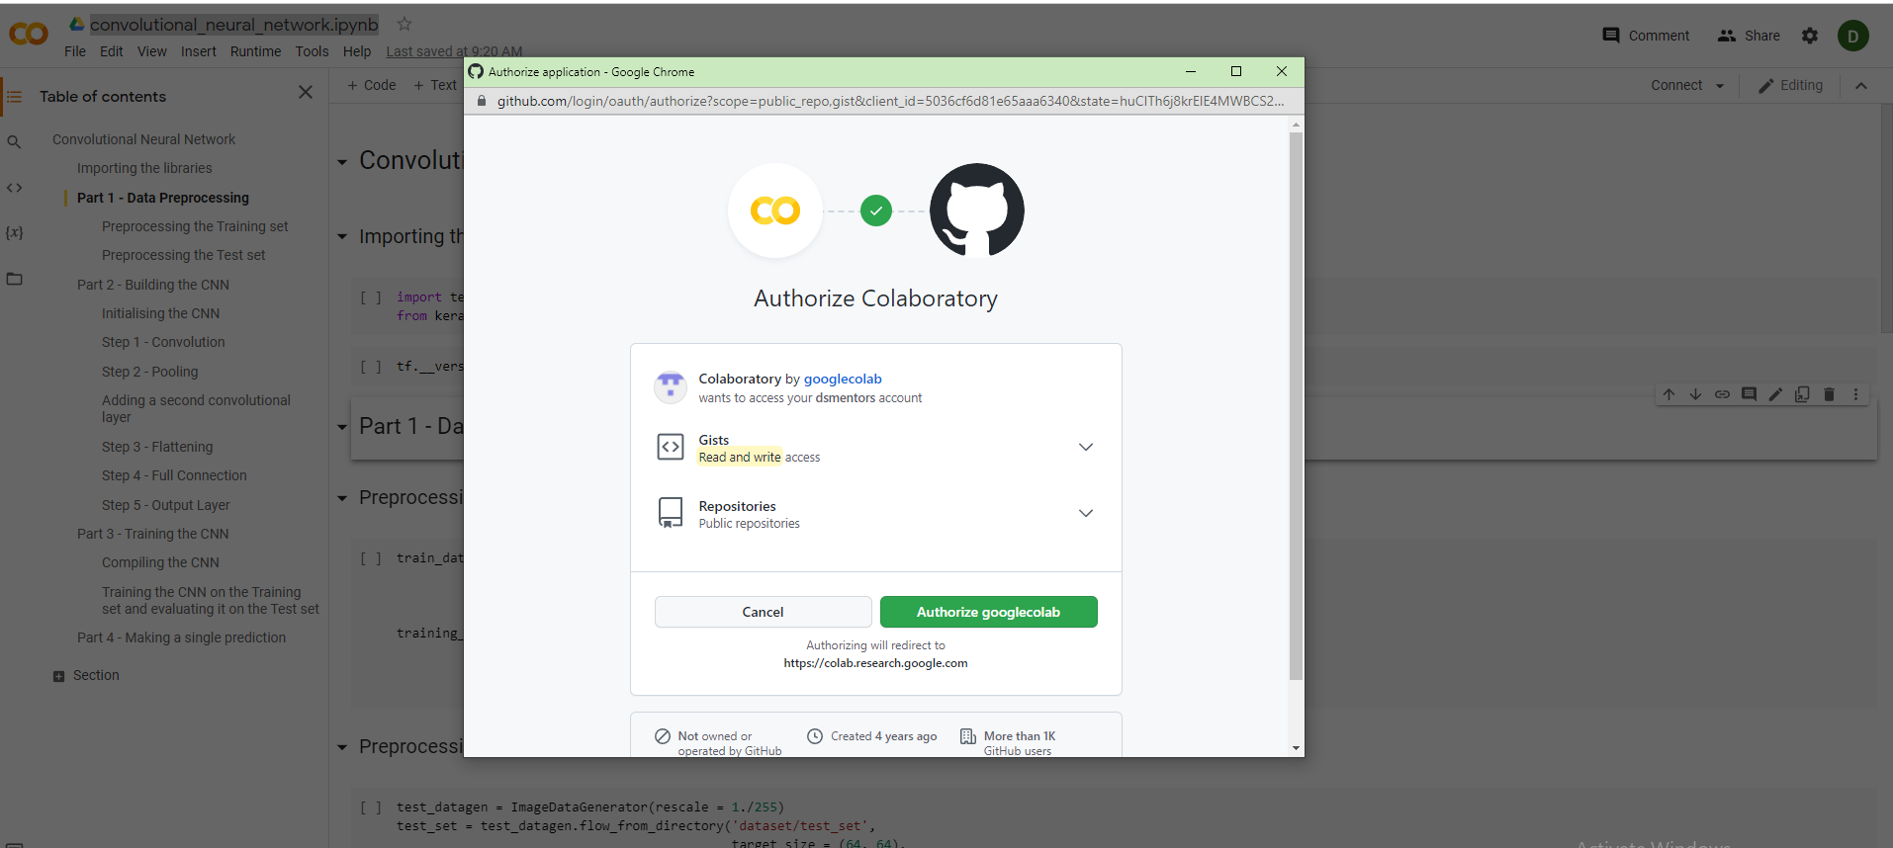
Click Authorize Googlecolab

Slide 29
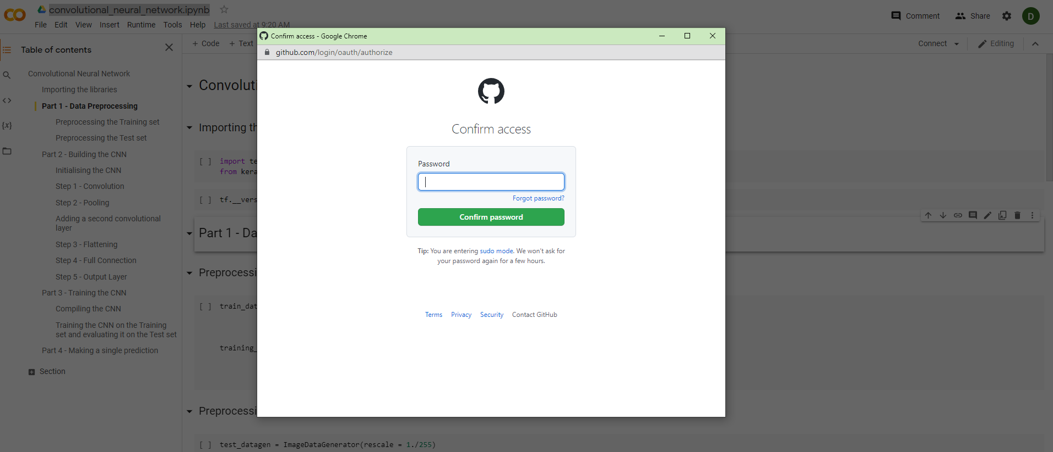
Enter your Git-Hub Password

Slide 30
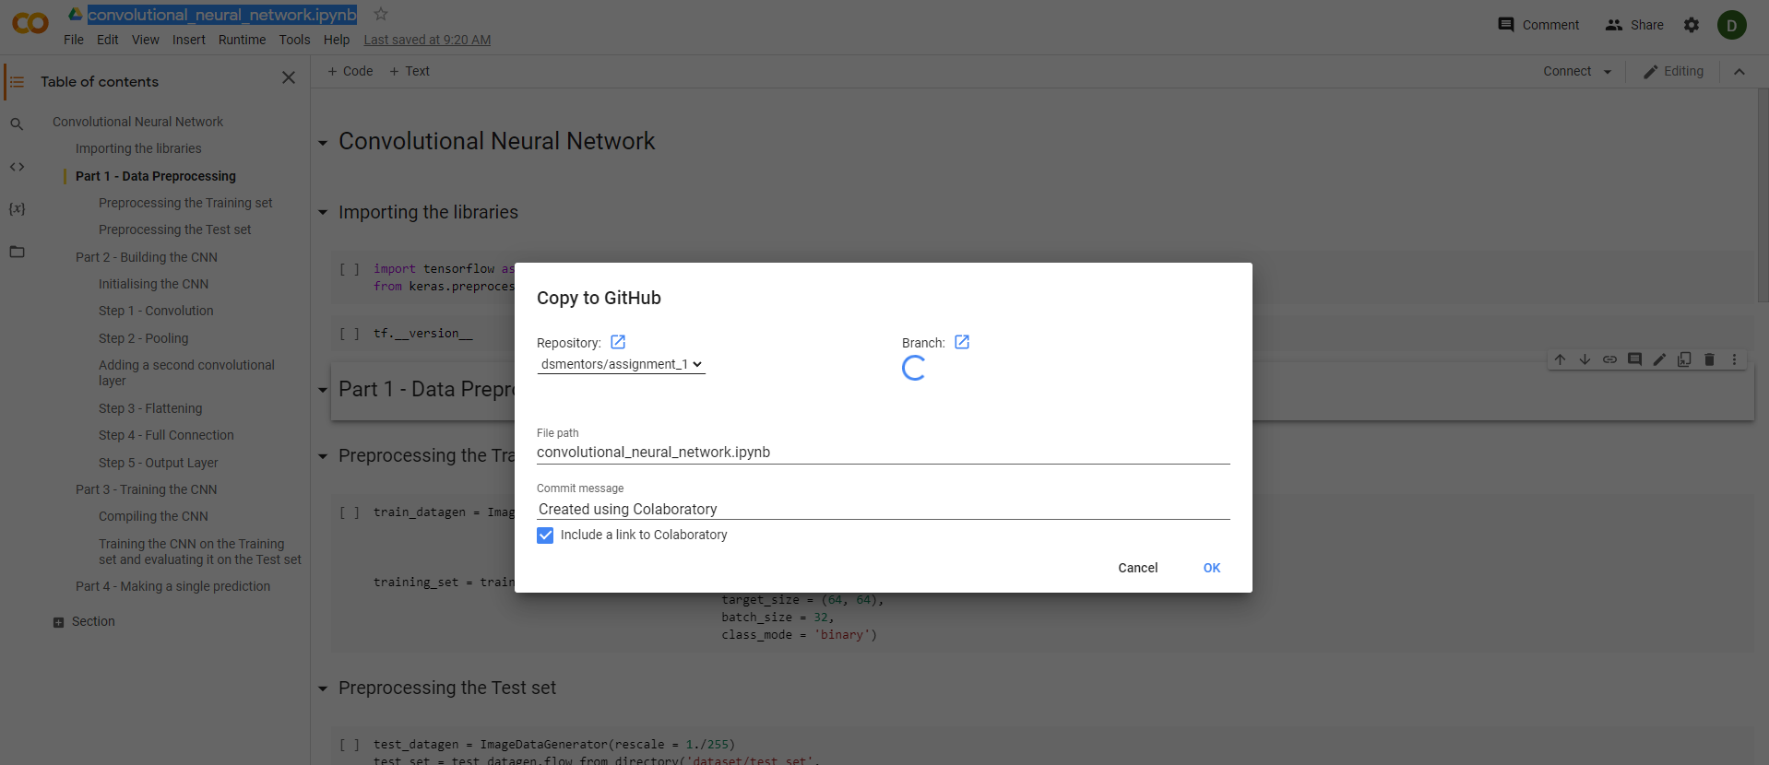
Select the repository you want to upload and press ‘ok’

Slide 31
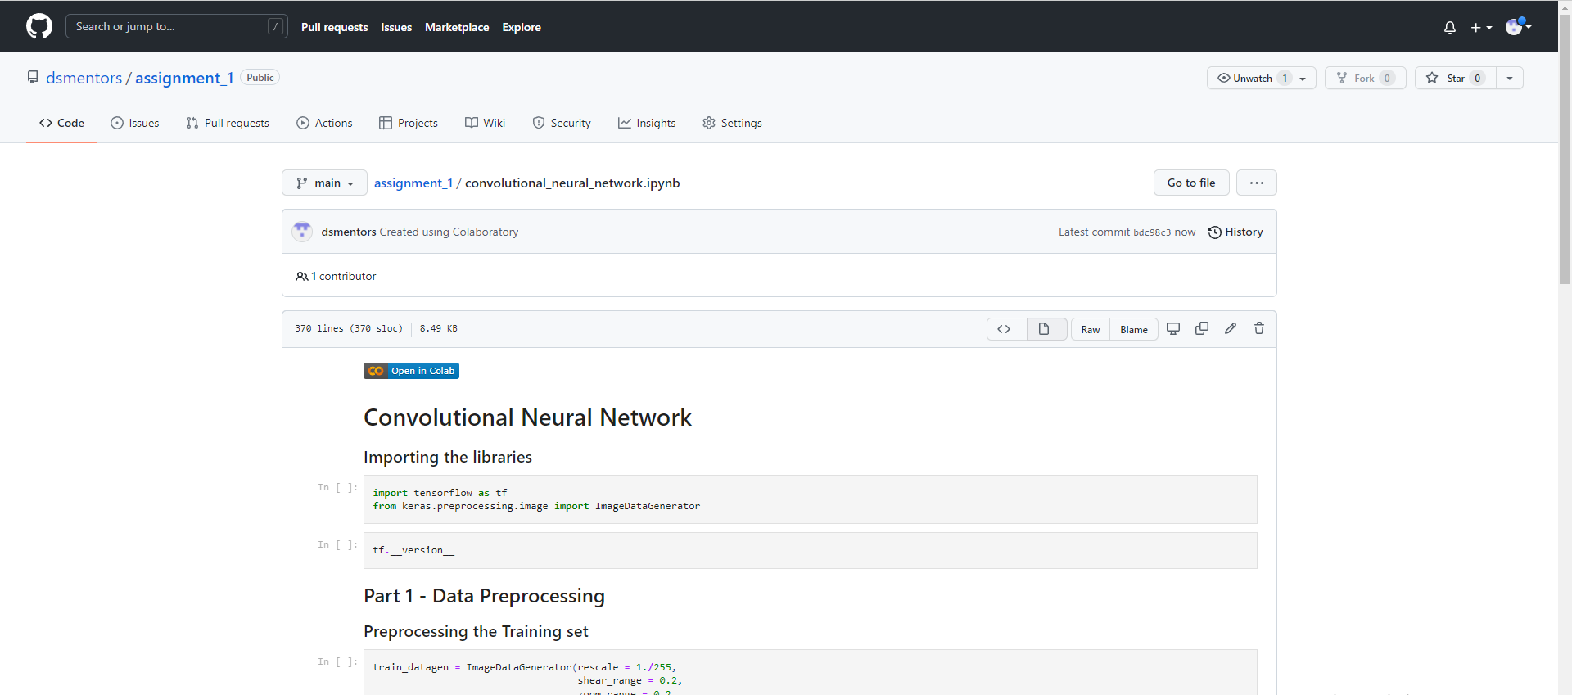
That will redirect to Git-Hub and your project was successfully uploaded in Git-Hub Repository

Slide 32
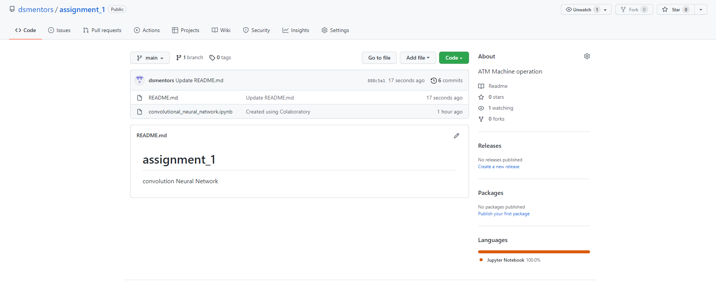
Add some Brief Description of Your Project in Read Me and your project is ready to share

